Slide 1


Australasian Applied Statistics Conference (AASC) Incorporating environmental covariates into a MET analysis with G×E×M interaction effects Michael Mumford Clayton Forknall Prof. Daniel Rodriguez Dr. Joe Eyre Dr. Alison Kelly December 1, 2022
Notes:
Good afternoon everyone, today I am going to be talking about the progress my collaborators and I have made on the development of statistical models that incorporate environmental covariates to better explain the genotype x environment x management practice interaction effect in sorghum agronomy trials

Slide 2
Background
The impact of genotype (G) × environment (E) interactions (G×E) is ubiquitous in the plant improvement literature (Cooper & Hammer 1996)
The factor analytic linear mixed model (FALMM, Smith et al. 2001) is a powerful tool for obtaining predictions for the G×E interaction from multi-environment trial (MET) data
Incorporates experimental design/randomisation into the analysis
Partitions treatment effects from spatial field variability
Accounts for complex variance structures
Notes:
The FALMM is the most common tool used to obtain accurate predictions for the GxE interaction effect.

Slide 3
Limitations of FALMM
The FALMM in the context of modelling G×E
Does not provide an understanding of the environmental drivers influencing the G×E pattern
Does not enable prediction at a ‘new’ untested environment
Does not (traditionally) incorporate for different management practices (M)
May not be appropriate when small number of genotypes are tested (Macdonald, 2018)
Some of these limitations can be addressed by the inclusion of environment covariates (ECs) into the MET analysis
Notes:
Does not provide biological understanding nor predictions in untested environment

Slide 4
Limitations of FALMM
The FALMM in the context of modelling G×E
Does not provide an understanding of the environmental drivers influencing the G×E pattern
Does not enable prediction at a ‘new’ untested environment
Does not (traditionally) incorporate for different management practices (M)
May not be appropriate when small number of genotypes are tested (Macdonald, 2018)
Some of these limitations can be addressed by the inclusion of environment covariates (ECs) into the MET analysis

Slide 5
Aims
Identify key environmental drivers contributing to the G×E×M interaction

Slide 6
Aims
Identify key environmental drivers contributing to the G×E×M interaction
Quantify the effect of key ECs with respect to trait of interest

Slide 7
Aims
Identify key environmental drivers contributing to the G×E×M interaction
Quantify the effect of key ECs with respect to trait of interest
3) Predict in an untested/future environment

Slide 8
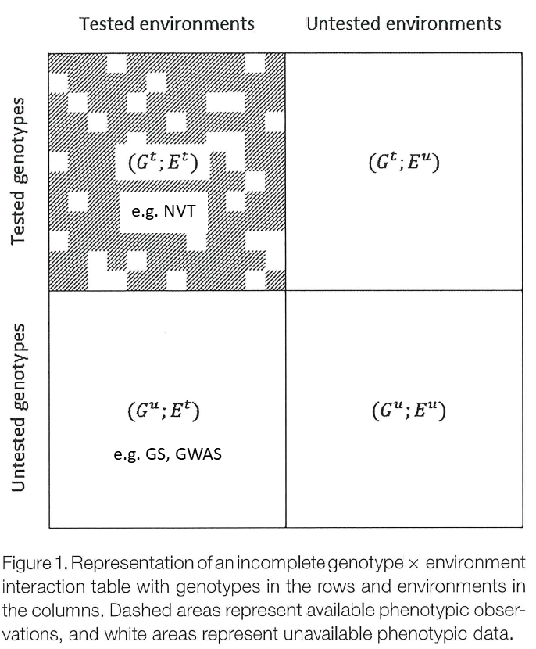
Incomplete G×E interaction table Malosetti et al. (2016)
The focus of today’s presentation!

Slide 9
MOTIVATING DATA

Slide 10
Description of Sorghum agronomy trials
6 trials
2-3 times of sowing (TOS) × 6-9 genotypes × 4 target plant populations (× 3 reps)
M
G
E
Trial | TOS 1 | TOS 2 | TOS 3 | # Genotypes | Target plant population (plants/m²) | Experimental Design
Breeza (Dryland) | 6/09/2018 | 17/09/2018 | 23/10/2018 | 6 | 3,6,9 & 12 | Split-split plot
Breeza (Irrigated) | 3/09/2018 | 18/09/2018 | 16/10/2018 | 8 | 3,6,9 & 12 | Split-split plot
Moree | 8/08/2018 | 12/09/2018 | 27/09/2018 | 8 | 3,6,9 & 12 | Split-split plot
Warra | 27/07/2018 | 19/10/2018 | 9/11/2018 | 9 | 3,6,9 & 12 | Split-plot
Surat | 8/08/2018 | 28/08/2018 | 24/01/2019 | 9 | 3,6,9 & 12 | Split-plot
Emerald | 26/07/2018 | 16/08/2018 |  | 8 | 3,6,9 & 12 | Split-split plot
Notes:
Here we are going to define environment as the combination of sowing time and trial, giving us a total of 17 environments

Slide 11
Description of Sorghum agronomy trials
6 trials
2-3 times of sowing (TOS) × 6-9 genotypes × 4 target plant populations (× 3 reps)
Environment defined as the combination of sowing time (TOS) and trial
Total of 17 environments
M
G
E
Trial | TOS 1 | TOS 2 | TOS 3 | # Genotypes | Target plant population (plants/m²) | Experimental Design
Breeza (Dryland) | 6/09/2018 | 17/09/2018 | 23/10/2018 | 6 | 3,6,9 & 12 | Split-split plot
Breeza (Irrigated) | 3/09/2018 | 18/09/2018 | 16/10/2018 | 8 | 3,6,9 & 12 | Split-split plot
Moree | 8/08/2018 | 12/09/2018 | 27/09/2018 | 8 | 3,6,9 & 12 | Split-split plot
Warra | 27/07/2018 | 19/10/2018 | 9/11/2018 | 9 | 3,6,9 & 12 | Split-plot
Surat | 8/08/2018 | 28/08/2018 | 24/01/2019 | 9 | 3,6,9 & 12 | Split-plot
Emerald | 26/07/2018 | 16/08/2018 |  | 8 | 3,6,9 & 12 | Split-split plot
Notes:
Here we are going to define environment as the combination of sowing time and trial, giving us a total of 17 environments

Slide 12
Description of Sorghum agronomy trials
6 trials
2-3 times of sowing (TOS) × 6-9 genotypes × 4 target plant populations (× 3 reps)
Environment defined as the combination of sowing time (TOS) and trial
Total of 17 environments
All other components of M (e.g. row spacing, nutrients) the same at all trials
Trial | TOS 1 | TOS 2 | TOS 3 | # Genotypes | Target plant population (plants/m²) | Experimental Design
Breeza (Dryland) | 6/09/2018 | 17/09/2018 | 23/10/2018 | 6 | 3,6,9 & 12 | Split-split plot
Breeza (Irrigated) | 3/09/2018 | 18/09/2018 | 16/10/2018 | 8 | 3,6,9 & 12 | Split-split plot
Moree | 8/08/2018 | 12/09/2018 | 27/09/2018 | 8 | 3,6,9 & 12 | Split-split plot
Warra | 27/07/2018 | 19/10/2018 | 9/11/2018 | 9 | 3,6,9 & 12 | Split-plot
Surat | 8/08/2018 | 28/08/2018 | 24/01/2019 | 9 | 3,6,9 & 12 | Split-plot
Emerald | 26/07/2018 | 16/08/2018 |  | 8 | 3,6,9 & 12 | Split-split plot
Notes:
Here we are going to define environment as the combination of sowing time and trial, giving us a total of 17 environments

Slide 13
STATISTICAL METHODS

Slide 14

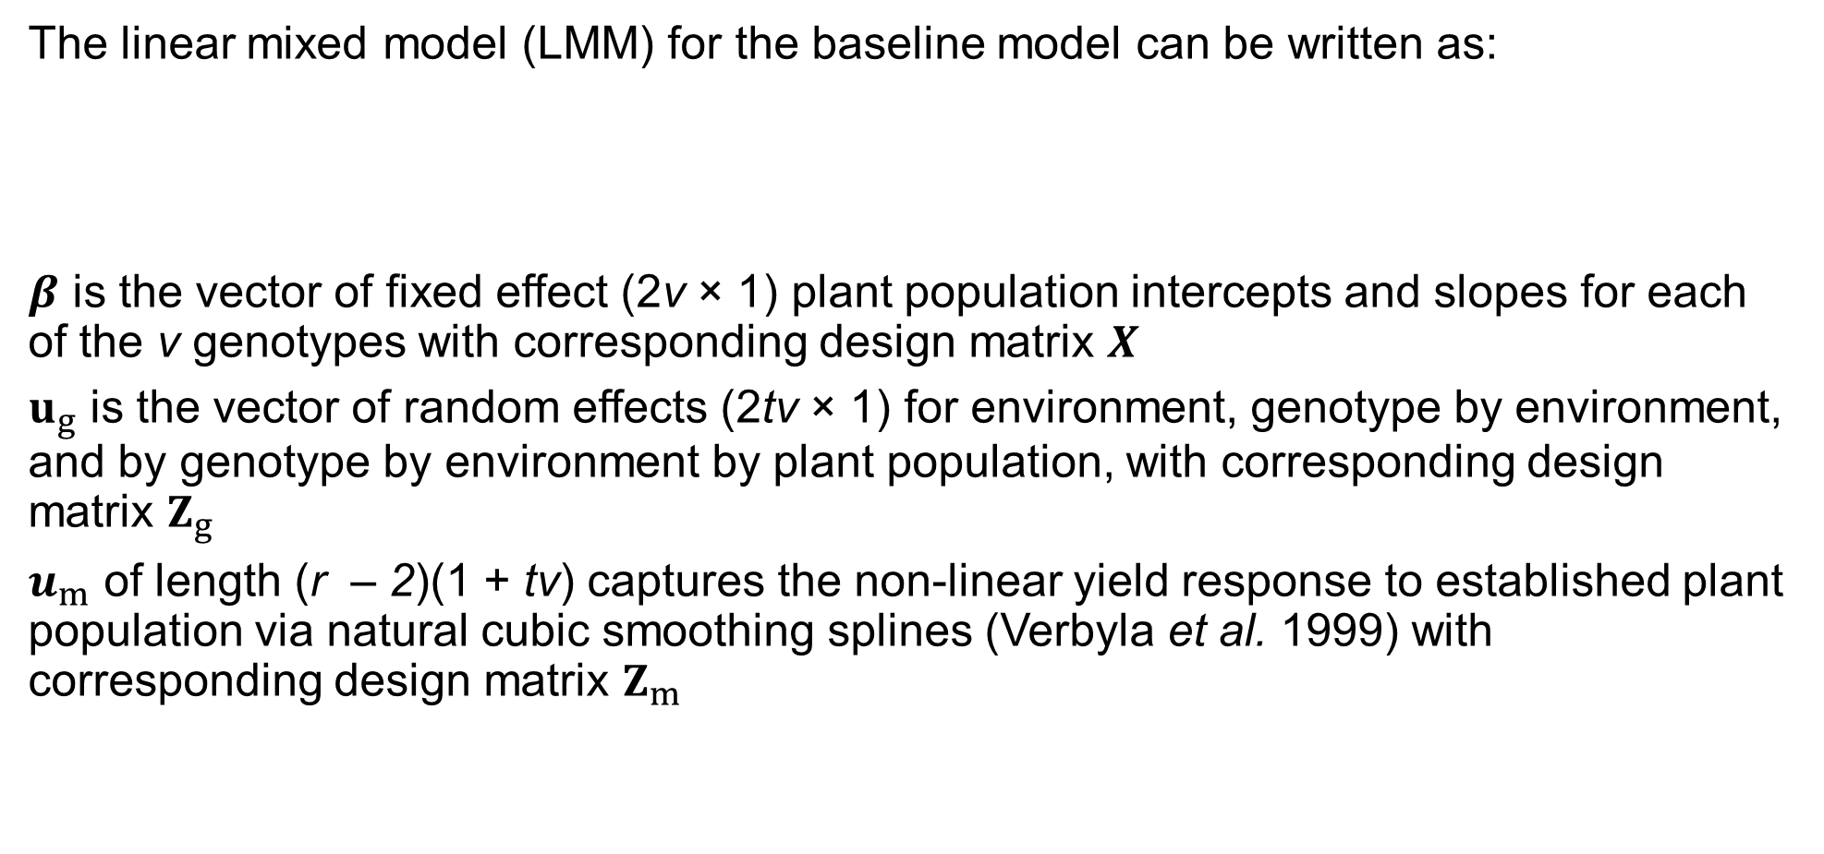
Statistical Methods – Baseline Model
The linear mixed model (LMM) for the baseline model can be written as:
$β$ is the vector of fixed effect (2v × 1) plant population intercepts and slopes for each of the v genotypes with corresponding design matrix $X$
$u_{g}$ is the vector of random effects (2tv × 1) for environment, genotype by environment, and by genotype by environment by plant population, with corresponding design matrix $Z_{g}$
$u_{m}$ of length (r – 2)(1 + tv) captures the non-linear yield response to established plant population via natural cubic smoothing splines (Verbyla et al. 1999) with corresponding design matrix $Z_{m}$
Notes:
All models use LMM framework & implemented using ASReml-R package

Slide 15
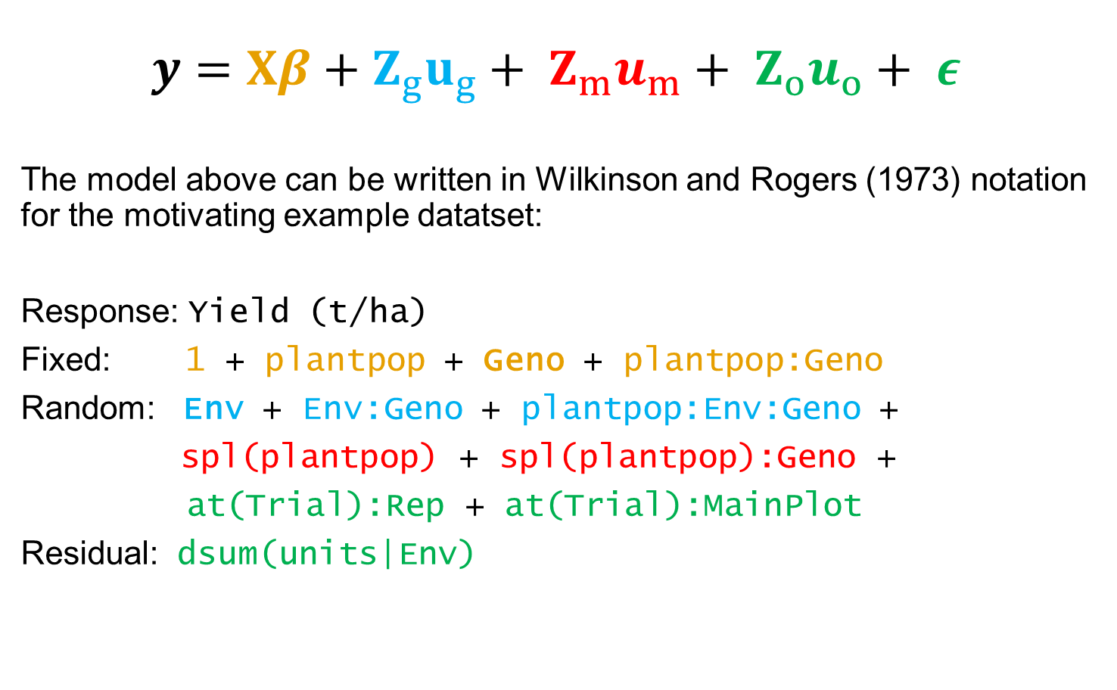
Statistical Methods – Baseline Model
$$y=Xβ+Z_{g}u_{g}+ Z_{m}u_{m}+ Z_{o}u_{o}+ ε$$
The model above can be written in Wilkinson and Rogers (1973) notation for the motivating example datatset:
Response: Yield (t/ha)
Fixed: 1 + plantpop + Geno + plantpop:Geno
Random: Env + Env:Geno + plantpop:Env:Geno +
spl(plantpop) + spl(plantpop):Geno +
at(Trial):Rep + at(Trial):MainPlot
Residual: dsum(units|Env)
Genotype & linear plant population (M) effects
Random environment (and G×E×M) effects
Non-linear plant population spline terms
Peripheral & residual effects

Slide 16

Statistical Methods – Baseline Model
$$y=Xβ+Z_{g}u_{g}+ Z_{m}u_{m}+ Z_{o}u_{o}+ ε$$
The model above can be written in Wilkinson and Rogers (1973) notation for the motivating example dataset:
Response: Yield (t/ha)
Fixed: 1 + plantpop + Geno + plantpop:Geno
Random: Env + Env:Geno + plantpop:Env:Geno +
spl(plantpop) + spl(plantpop):Geno +
at(Trial):Rep + at(Trial):MainPlot
Residual: dsum(units|Env)
Genotype fixed, environment random
Genotype & linear plant population (M) effects
Random environment (and G×E×M) effects
Non-linear plant population spline terms
Peripheral & residual effects

Slide 17
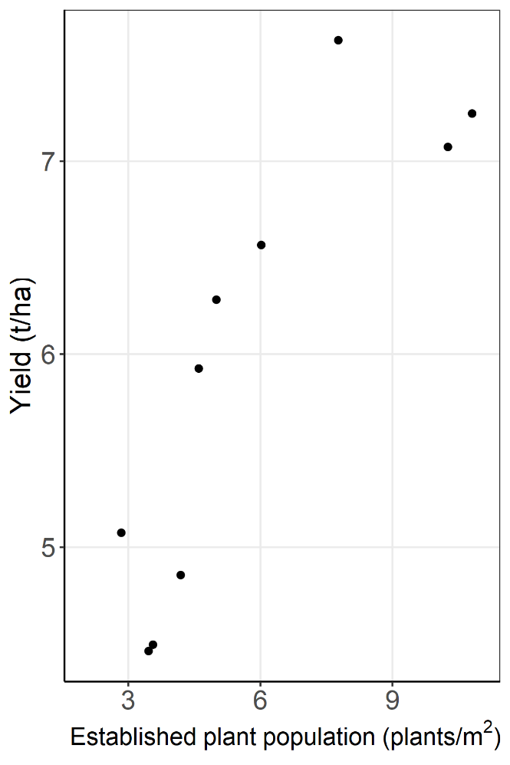

Statistical Methods – Baseline Model
$$y=Xβ+Z_{g}u_{g}+ Z_{m}u_{m}+ Z_{o}u_{o}+ ε$$
The model above can be written in Wilkinson and Rogers (1973) notation for the motivating example dataset:
Response: Yield (t/ha)
Fixed: 1 + plantpop + Geno + plantpop:Geno
Random: Env + Env:Geno + plantpop:Env:Geno +
spl(plantpop) + spl(plantpop):Geno +
at(Trial):Rep + at(Trial):MainPlot
Residual: dsum(units|Env)
Non-linear yield response to established plant population captured via natural cubic smoothing splines
Notes:
Mention Verbyla 1999

Slide 18
Statistical Methods – Baseline Model
$$y=Xβ+Z_{g}u_{g}+ Z_{m}u_{m}+ Z_{o}u_{o}+ ε$$
The model above can be written in Wilkinson and Rogers (1973) notation for the motivating example dataset:
Response: Yield (t/ha)
Fixed: 1 + plantpop + Geno + plantpop:Geno
Random: Env + Env:Geno + plantpop:Env:Geno +
spl(plantpop) + spl(plantpop):Geno +
at(Trial):Rep + at(Trial):MainPlot
Residual: dsum(units|Env)
Spatial trend adjusted using Gilmour et al. 1997
Genotype & linear plant population (M) effects
Random environment (and G×E×M) effects
Non-linear plant population spline terms
Peripheral & residual effects

Slide 19
Statistical Methods – Baseline Model
$$y=Xβ+Z_{g}u_{g}+ Z_{m}u_{m}+ Z_{o}u_{o}+ ε$$
The model above can be written in Wilkinson and Rogers (1973) notation for the motivating example dataset:
Response: Yield (t/ha)
Fixed: 1 + plantpop + Geno + plantpop:Geno
Random: Env + Env:Geno + plantpop:Env:Geno +
spl(plantpop) + spl(plantpop):Geno +
at(Trial):Rep + at(Trial):MainPlot
Residual: dsum(units|Env)
Genotype & linear plant population (M) effects
Random environment (and G×E×M) effects
Non-linear plant population spline terms
Peripheral & residual effects
Heterogeneous residual variance

Slide 20
Incorporating Environmental Covariates

Slide 21
Environmental covariate data
Environmental covariate (EC) | Acronym | Mean | Min | Max | Observational unit for EC
Pre-flowering rainfall (mm) | PreFlwRain | 173 | 11 | 375 | G×E
Post-flowering rainfall (mm) | PostFlwRain | 70 | 0 | 245 | G×E
Irrigation (mm) | Irrig | 40 | 0 | 127 | Trial
Initial soil water | ISW | 177 | 97 | 280 | Trial
Pre-flowering maximum temperature (°C) | PreMaxT | 30.6 | 26 | 35.7 | G×E
Post-flowering maximum temperature (°C) | PostMaxT | 34.8 | 27.9 | 39.7 | G×E
Pre-flowering minimum temperature (°C) | PreMinT | 14.5 | 9.3 | 22.3 | G×E
Post-flowering minimum temperature (°C) | PostMinT | 18.8 | 11.8 | 22.4 | G×E
Pre-flowering radiation (MJ/day) | PreFlwRad | 20.5 | 17 | 24 | G×E
Post-flowering radiation (MJ/day) | PostFlwRad | 23 | 13.9 | 28.8 | G×E
Pre-flowering cumulative solar radiation (MJ) | PreCumRad | 1602 | 948 | 2196 | G×E
Post-flowering cumulative solar radiation (MJ) | PostCumRad | 995 | 586 | 1685 | G×E
Pre-flowering evapotranspiration (mm) | PreFlwEvap | 486 | 291 | 625 | G×E
Post-flowering evapotranspiration (mm) | PostFlwEvap | 336 | 181 | 582 | G×E
Mean photo-thermal quotient around flowering (MJ/°C day) | ptq | 0.89 | 0.68 | 1 | G×E
Normalised ptq around flowering (MJ.kPa/°C day) | NPTq | 0.52 | 0.28 | 0.79 | G×E
Mean soil temperature (7cm depth) sowing to emergence (°C) | AvgSoilTemp | 18.5 | 12.6 | 29.2 | G×E
Water deficit index (mm) | Deficit | 545 | 171 | 811 | G×E
Seed set (%) | SeedSet | 74.4 | 19.8 | 99.4 | G×E
Weather
Soil
APSIM derived
Notes:
Combining the phenology and weather station data, a total of 19 distinct environmental covariates were derived for each environment where phenology consists of recorded measurements of emergence, flowering and harvest day for each genotype within an environment.
Thus most environmental covariates have a unique value for each genotype by environment combination as shown in this last column.

Slide 22

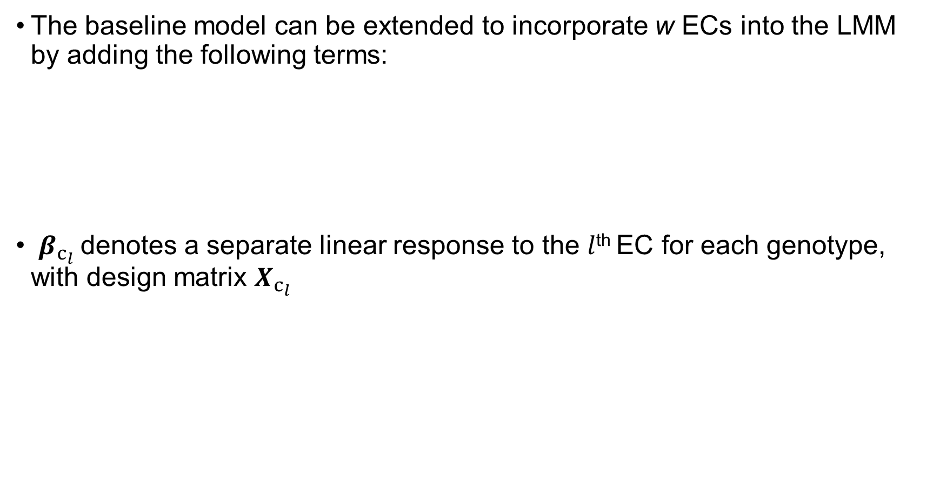
Statistical Model – Incorporating ECs
The baseline model can be extended to incorporate w ECs into the LMM by adding the following terms:
$β_{c_{l}}$denotes a separate linear response to the $l$^{th} EC for each genotype, with design matrix $X_{c_{l}}$
$$\sum_{l=1}^{w}{\left(X_{c_{l}}β_{c_{l}}+Z_{c_{l}}u_{c_{l}}+g_{l}\right)}$$

Slide 23
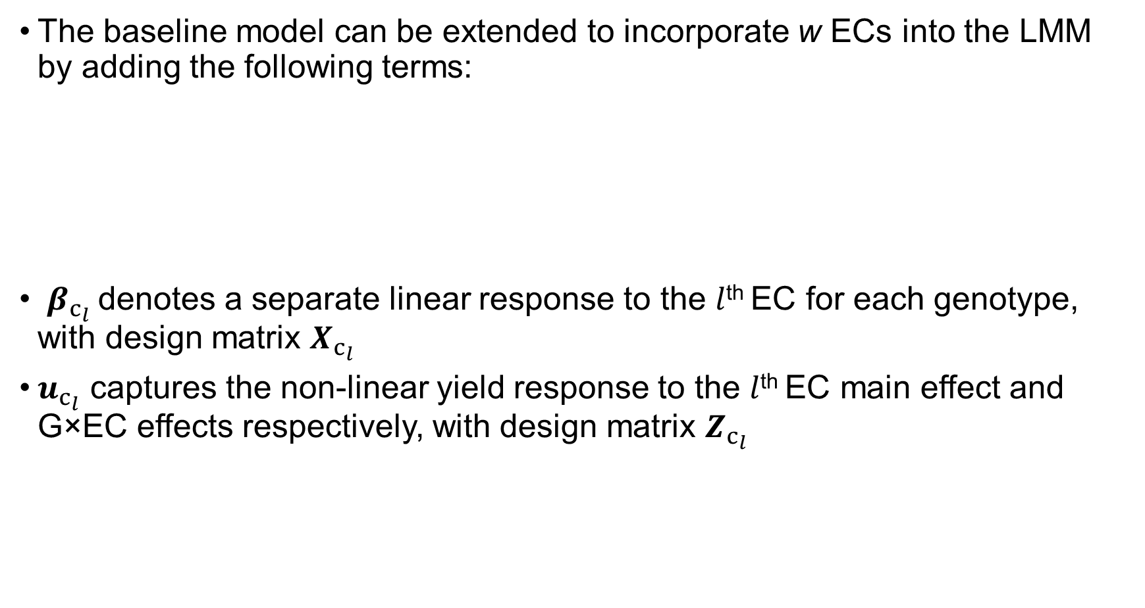
Statistical Model – Incorporating ECs
The baseline model can be extended to incorporate w ECs into the LMM by adding the following terms:
$β_{c_{l}}$denotes a separate linear response to the $l$^{th} EC for each genotype, with design matrix $X_{c_{l}}$
$u_{c_{l}}$ captures the non-linear yield response to the $l$^{th} EC main effect and G×EC effects respectively, with design matrix $Z_{c_{l}}$
$$\sum_{l=1}^{w}{\left(X_{c_{l}}β_{c_{l}}+Z_{c_{l}}u_{c_{l}}+g_{l}\right)}$$

Slide 24

Statistical Model – Incorporating one EC
$$y=Xβ+X_{c_{l}}β_{c_{l}}+Z_{g}u_{g}+ Z_{m}u_{m}+Z_{c_{l}}u_{c_{l}}+g_{l}+Z_{o}u_{o}+ ε$$
Linear EC and G×EC terms
Non-linear G and G×EC terms (i.e. spline terms)
EC×M interaction
The Wilkinson & Rogers notation for a single (say $l$^{th}) EC incorporated into the LMM is:
Response: Yield (t/ha)
Fixed: 1 + plantpop + plantpop:Geno + ec + ec:Geno + plantpop:ec + plantpop:ec:Geno
Random: Env + Env:Geno + plantpop:Geno + spl(plantpop) + spl(plantpop):Geno + spl(ec) + spl(ec):Geno + plantpop:spl(ec) + plantpop:spl(ec):Geno + spl(plantpop):ec + spl(plantpop):ec:Geno +
spl(plantpop):spl(ec) + spl(plantpop):spl(ec):Geno + at(Trial):Rep + at(Trial):MainPlot
Residual: dsum(units|Env)

Slide 25
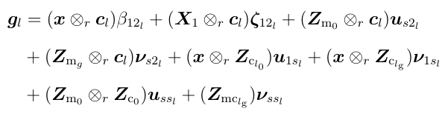

Statistical Model – Incorporating one EC
$$y=Xβ+X_{c_{l}}β_{c_{l}}+Z_{g}u_{g}+ Z_{m}u_{m}+Z_{c_{l}}u_{c_{l}}+g_{l}+Z_{o}u_{o}+ ε$$
EC×M interaction
Response: Yield (t/ha)
Fixed: 1 + plantpop + plantpop:Geno + ec + ec:Geno + plantpop:ec + plantpop:ec:Geno
Random: Env + Env:Geno + plantpop:Geno + spl(plantpop) + spl(plantpop):Geno + spl(ec) + spl(ec):Geno + plantpop:spl(ec) + plantpop:spl(ec):Geno + spl(plantpop):ec + spl(plantpop):ec:Geno +
spl(plantpop):spl(ec) + spl(plantpop):spl(ec):Geno + at(Trial):Rep + at(Trial):MainPlot
Residual: dsum(units|Env)
Notes:
Mention Verbyla 2018

Slide 26
Statistical Model – Incorporating one EC
$$y=Xβ+X_{c_{l}}β_{c_{l}}+Z_{g}u_{g}+ Z_{m}u_{m}+Z_{c_{l}}u_{c_{l}}+g_{l}+Z_{o}u_{o}+ ε$$
EC×M interaction
Response: Yield (t/ha)
Fixed: 1 + plantpop + plantpop:Geno + ec + ec:Geno + plantpop:ec + plantpop:ec:Geno
Random: Env + Env:Geno + plantpop:Geno + spl(plantpop) + spl(plantpop):Geno + spl(ec) + spl(ec):Geno + plantpop:spl(ec) + plantpop:spl(ec):Geno + spl(plantpop):ec + spl(plantpop):ec:Geno +
spl(plantpop):spl(ec) + spl(plantpop):spl(ec):Geno + at(Trial):Rep + at(Trial):MainPlot
Residual: dsum(units|Env)

Slide 27
Statistical Model – Incorporating ECs
The baseline model can be extended to incorporate ECs into the LMM by adding the following terms:
Linear EC and G×EC terms
Non-linear G and G×EC terms (i.e. splines)
EC×M interaction
Forward selection: Perform k-fold cross validation for each EC at each iteration
$$\sum_{l=1}^{w}{\left(X_{c_{l}}β_{c_{l}}+Z_{c_{l}}u_{c_{l}}+g_{l}\right)}$$

Slide 28
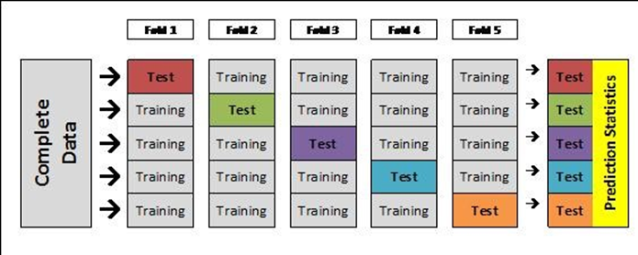
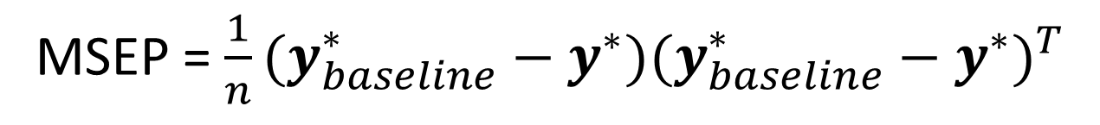
k-fold cross validation diagram (k=5)
Source: https://stackoverflow.com/questions/40368467/cross-validation-extracting-the-model-values-out-per-row
$$y$$
$$y^{∗}$$
MSEP = $\frac{1}{n}{(y_{baseline}^{∗}−y^{∗})(y_{baseline}^{∗}−y^{∗})}^{T}$

Slide 29
Statistical Model – Incorporating ECs
The baseline model can be extended to incorporate ECs into the LMM by adding the following terms:
Linear EC and G×EC terms
Non-linear G and G×EC terms (i.e. splines)
EC×M interaction
Forward selection: Perform k-fold cross validation for each EC at each iteration
Backwards selection: Wald test (Kenward & Roger, 1997) for fixed effects, AIC (Verbyla, 2019) for random (e.g. spline) terms
$$\sum_{l=1}^{w}{\left(X_{c_{l}}β_{c_{l}}+Z_{c_{l}}u_{c_{l}}+g_{l}\right)}$$

Slide 30
Flow chart - Subset selection procedure
Perform individual trial analysis adding spatial terms and removing outliers as required
Fit Baseline Model to the MET data and set Baseline Model equal to Current Model
Commence forward selection procedure iteratively testing all EC Candidate Models
Add the ‘l^{th}’ EC to the Current Model to form the ‘l^{th}’ EC Candidate model, perform 6 fold leave-one-trial-out cross validation and calculate RMSEP
NO
Have all l EC Candidate Models been iteratively fit?
YES
Does the selected EC still appear in the Candidate Model after the backwards selection procedure?
Select EC Candidate Model with the lowest RMSEP and
Set Current Model equal to the Candidate Model which incorporates an additional EC
Does the Current Model have a lower RMSEP than all l EC Candidate Models?
YES
then perform backwards selection to remove non-significant EC terms and then update EC Candidate Model.
NO
Exclude this EC Candidate model from this iteration
Baseline model
Forward selection
NO
YES
Set final model equal to the current model and obtain predictions from the final model
Backward selection
Variable selection
FINISH!
Notes:
The process of indeitifying the most important EC contributing to the GxExM interaction is summasrised by this flow diagram.

Slide 31
RESULTS

Slide 32
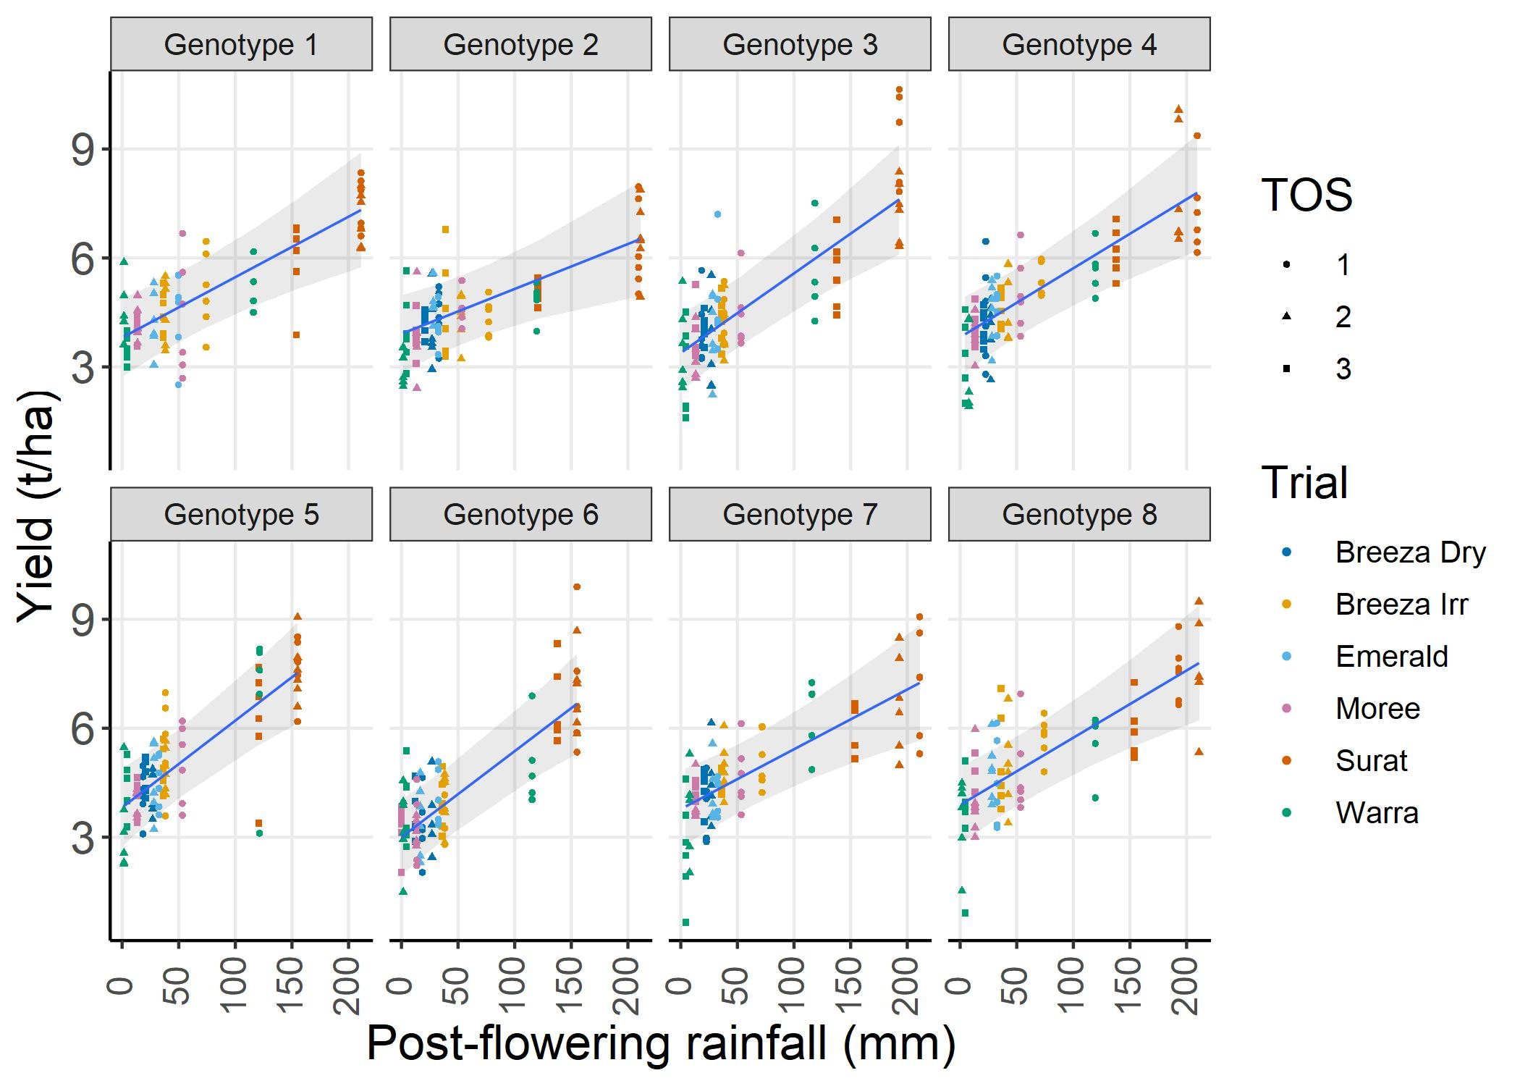
Results: Post-flowering rainfall
Points denote grain yield values adjusted for all other environmental covariates & environment lack of fit terms.

Slide 33
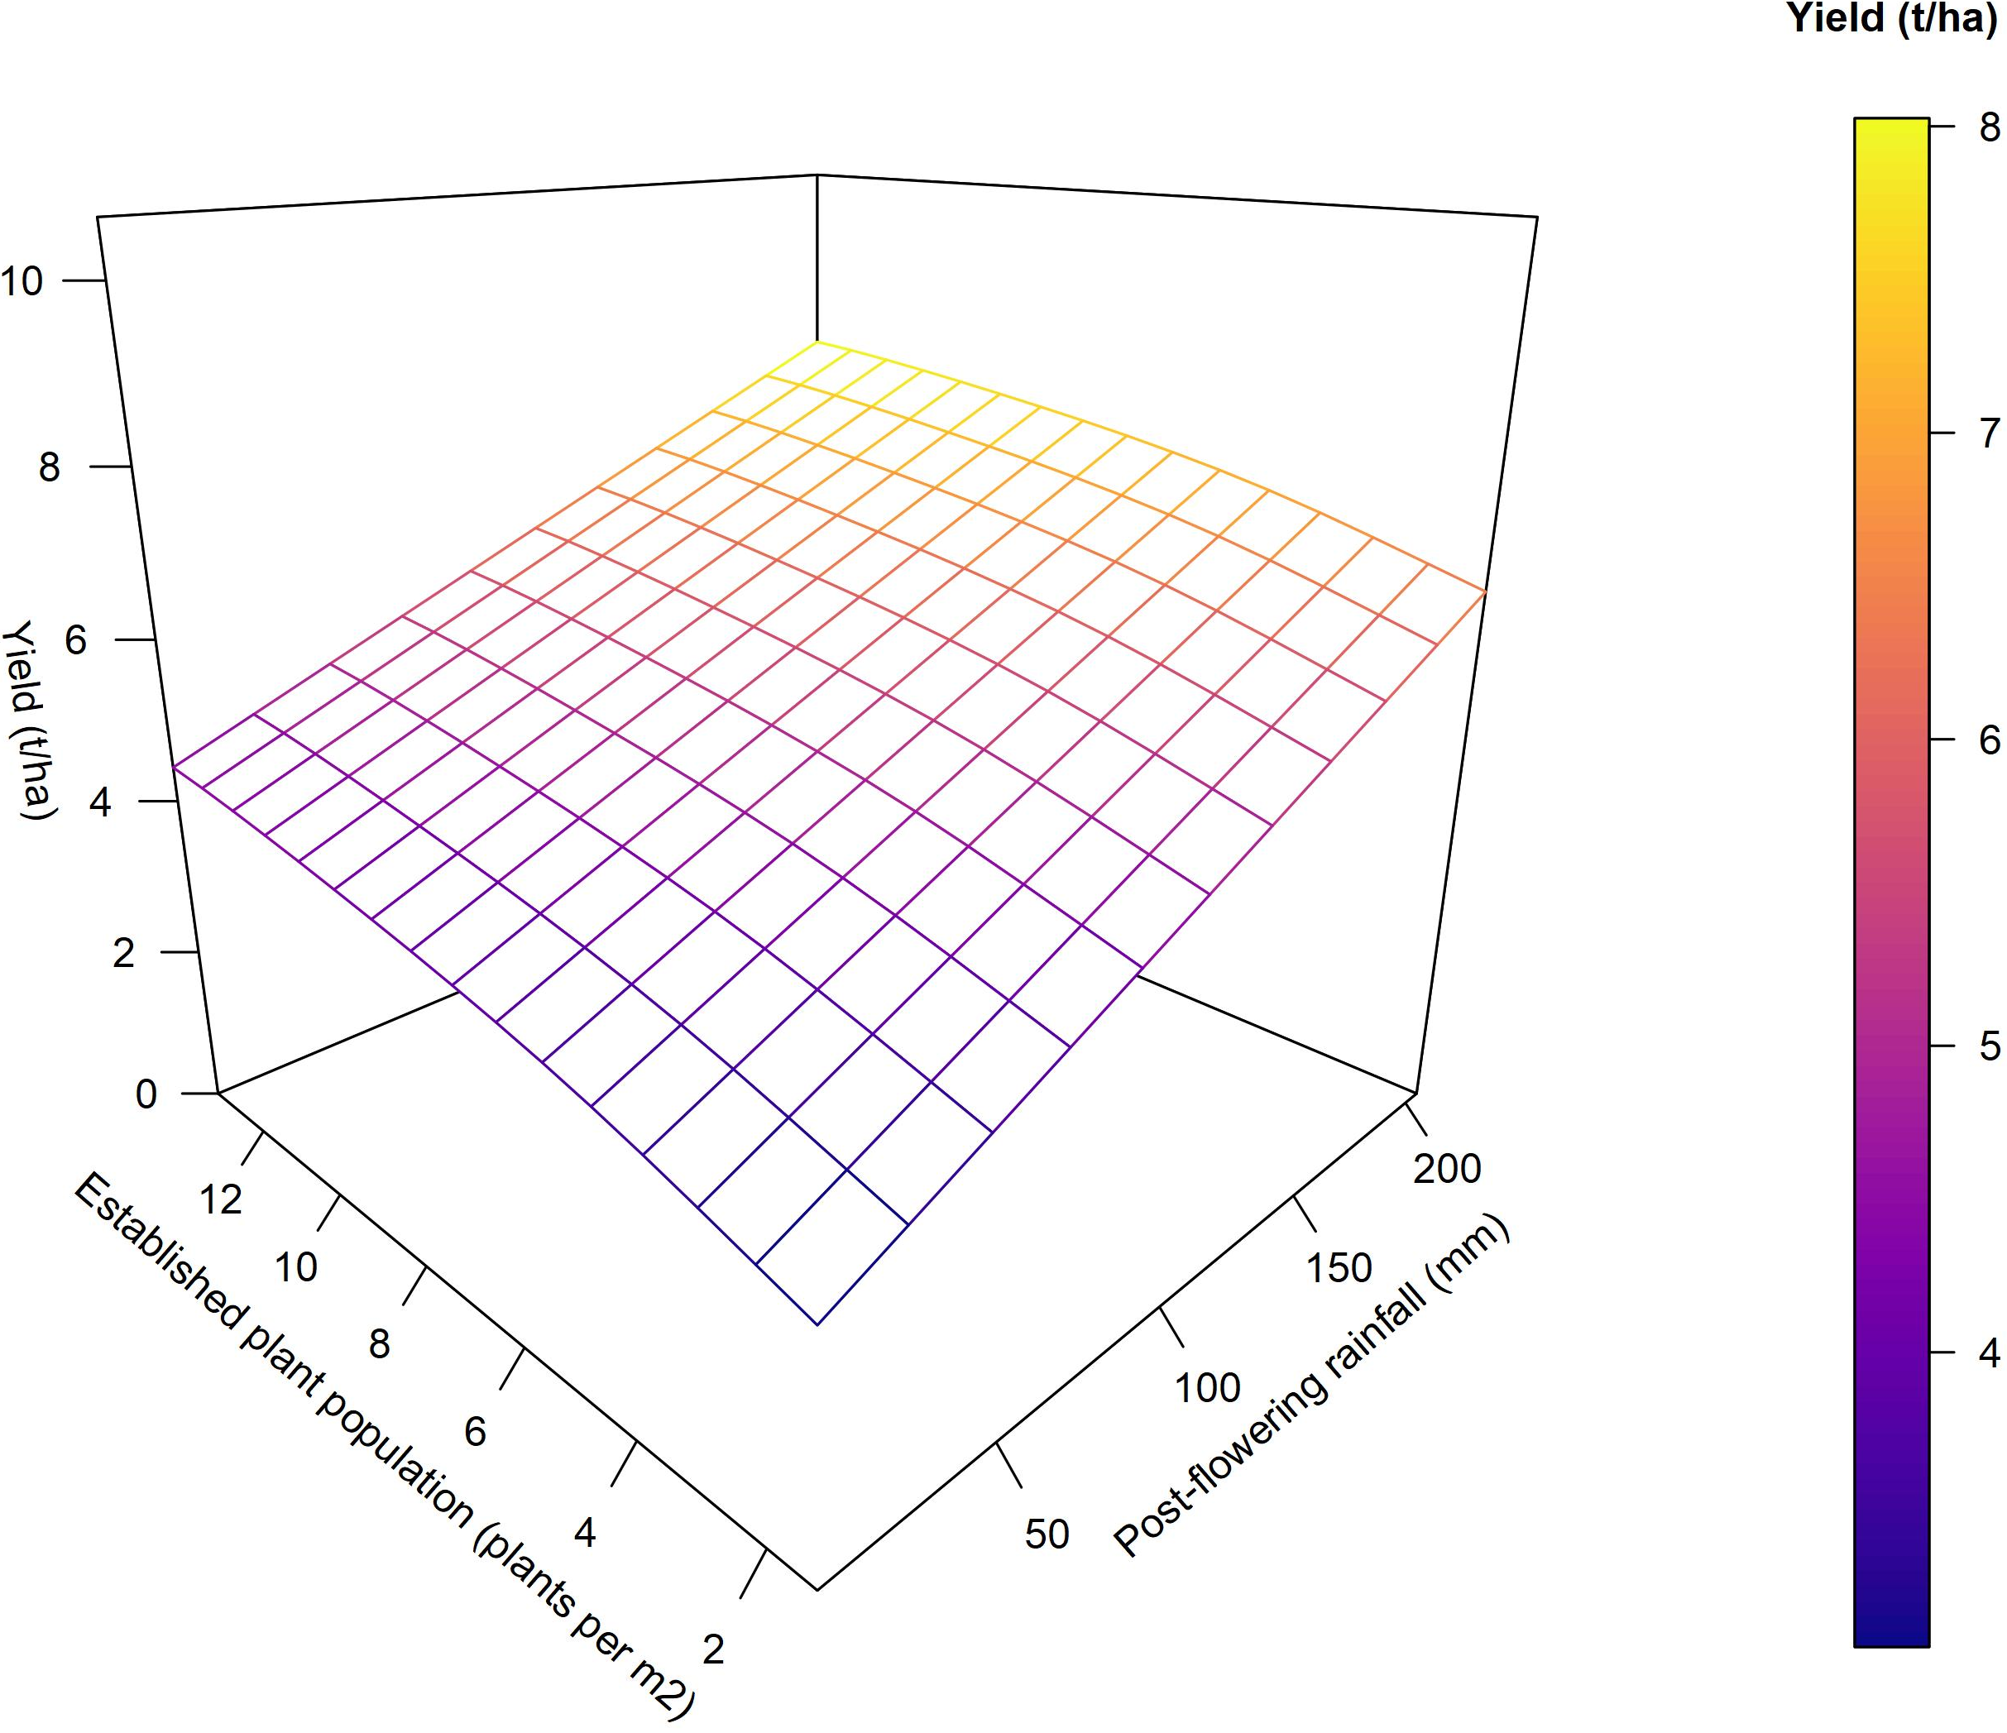
Results: Post-flowering rainfall

Slide 34
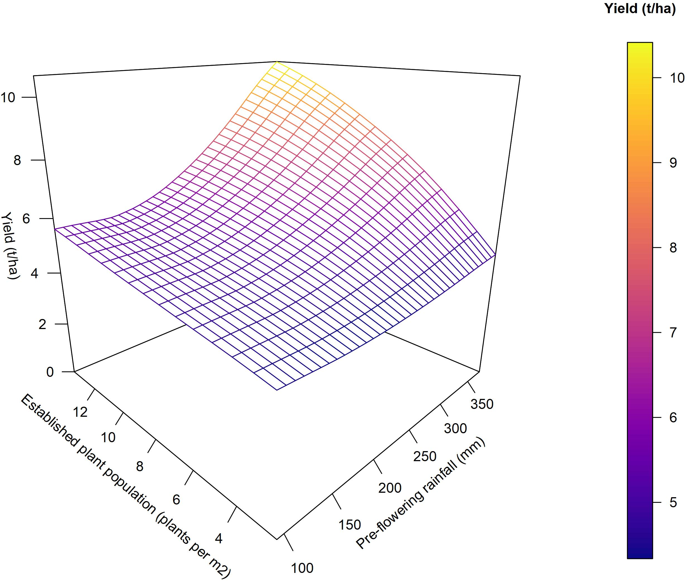
Results: Pre-flowering rainfall

Slide 35
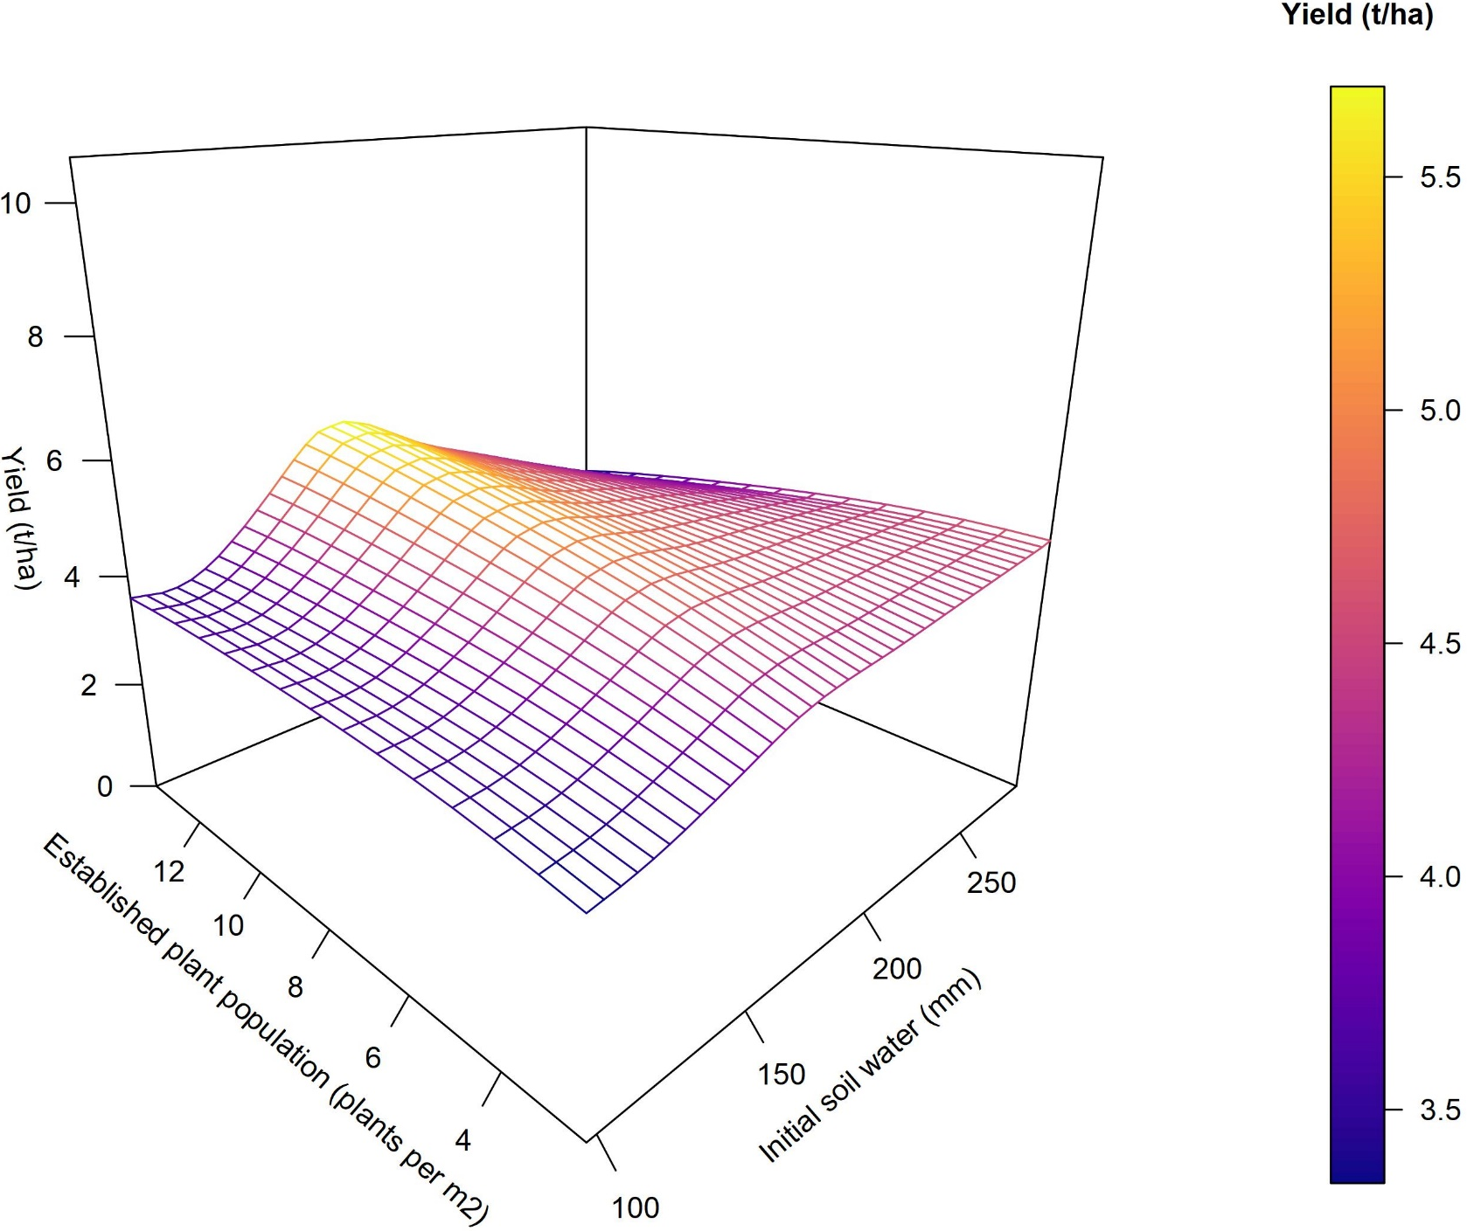
Results: Initial soil water

Slide 36
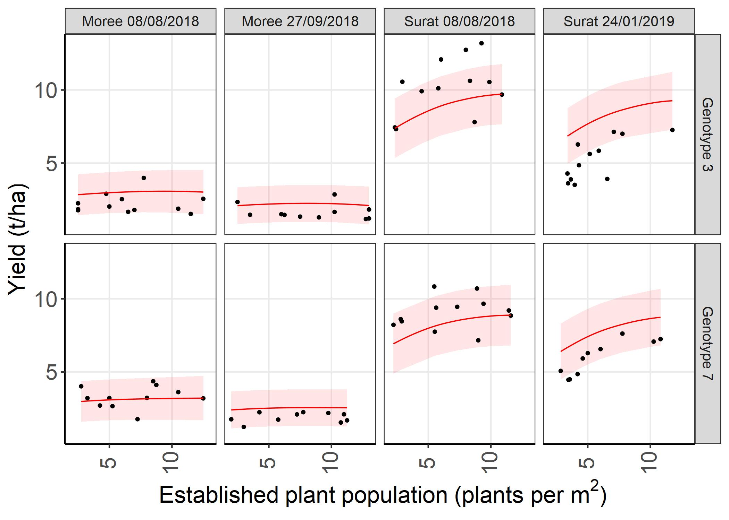
Yield response to established plant population: predictions 2018/19 data
Red = tested genotype, tested environment
Shaded area = 95% prediction interval

Slide 37
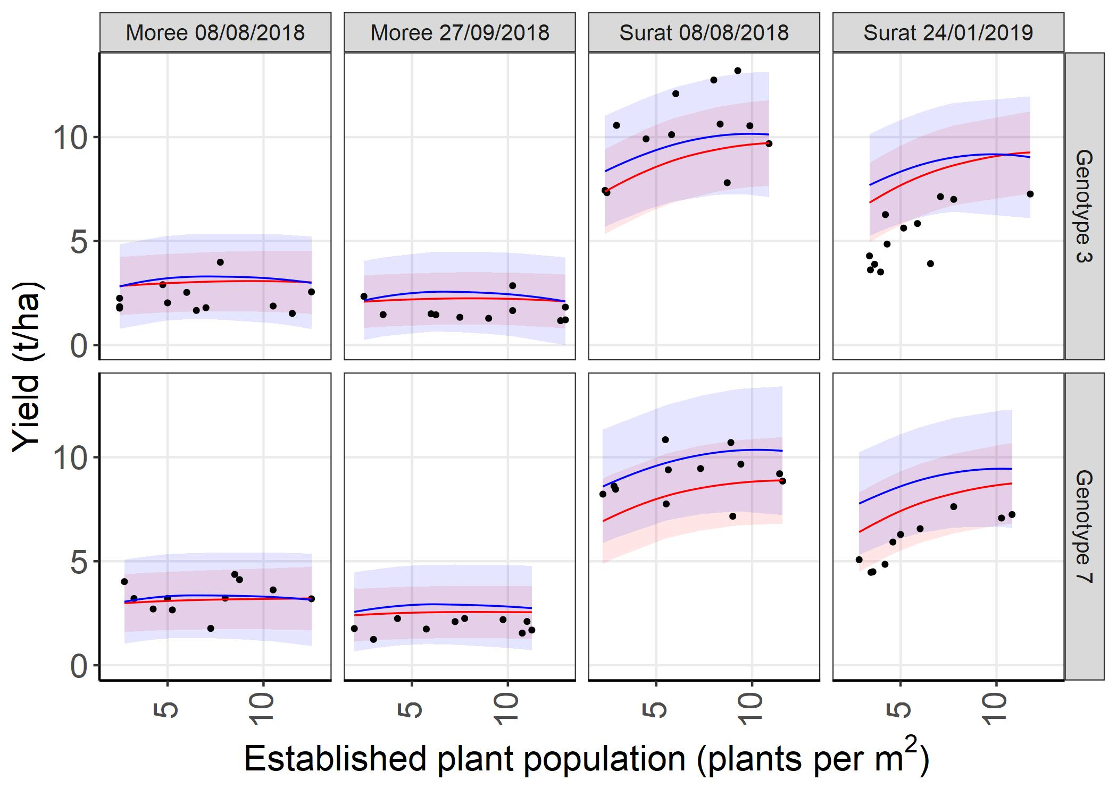
Yield response to established plant population: predictions 2018/19 data
Red = tested genotype, tested environment
Blue = tested genotype, untested environment
Shaded area = 95% prediction interval

Slide 38
Conclusion
A new statistical methodology was proposed and applied to a series of sorghum agronomy trials that:
Identified key ECs contributing to the GxExM interaction. ✓
Quantified the effect of each EC with respect to yield. ✓
Predicted for any observed value of established plant population. ✓
Can predict in a future or untested environment ✓

Slide 39
Acknowledgements
We would like to acknowledge the Grains Research Development Corporation for their financial support of sorghum agronomy research which is conducted under GRDC projects UOQ 1808-001RTX and the SAGI-North project (DAQ00208).

Slide 40
Journal article (in preparation)
Mumford, M. H., Forknall, C. R., Rodriguez, D., Eyre, J., Kelly, A. M. (In preparation). A one-stage predictive model for the genotype x environment × management (G×E×M) interaction incorporating environmental covariates.

Slide 41
References
Cooper, M. and Hammer, G.L. (1996). Plant adaptation and crop improvement. IRRI.
Kenward, M. G., & Roger, J. H. (1997). Small sample inference for fixed effects from restricted maximum likelihood. Biometrics, 983-997
Macdonald, B., (2018). How low can you go? Performance of factor analytic models in the analysis of multi-environment trials with small numbers of varieties. Honours thesis. University of Southern Queensland
Malosetti, M., Bustos‐Korts, D., Boer, M.P. and van Eeuwijk, F.A. (2016). Predicting responses in multiple environments: issues in relation to genotype × environment interactions. Crop Science, 56(5), pp.2210-2222. Smith, A., Cullis, B., & Thompson, R. (2001). Analyzing variety by environment data using multiplicative mixed models and adjustments for spatial field trend. Biometrics, 57(4), 1138-1147.
Smith, A. B., Cullis, B. R., & Thompson, R. (2005). The analysis of crop cultivar breeding and evaluation trials: an overview of current mixed model approaches. The Journal of Agricultural Science, 143(6), 449-462.
Verbyla, A.P., Cullis, B.R., Kenward, M.G. and Welham, S.J. (1999). The analysis of designed experiments and longitudinal data by using smoothing splines. Journal of the Royal Statistical Society: Series C (Applied Statistics), 48(3), pp.269-311.
Verbyla, A.P., De Faveri, J., Wilkie, J.D. and Lewis, T. (2018). Tensor cubic smoothing splines in designed experiments requiring residual modelling. Journal of Agricultural, Biological and Environmental Statistics, 23(4), pp.478-508.
Verbyla, A. P. (2019). A note on model selection using information criteria for general linear models estimated using REML. Australian & New Zealand Journal of Statistics, 61(1), 39-50.
Wilkinson, G. N., & Rogers, C. E. (1973). Symbolic description of factorial models for analysis of variance. Journal of the Royal Statistical Society: Series C (Applied Statistics), 22(3), 392-399.
Notes:
Thank you!

